Slide 1
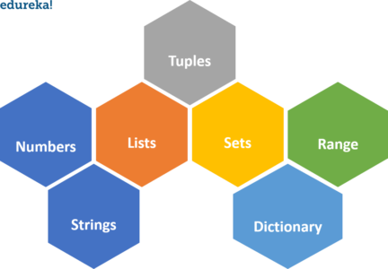
Data Types in Python

Slide 2
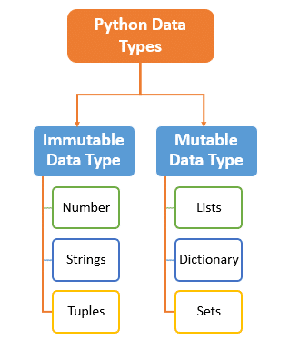
Mutable and Immutable
Mutable Data Types:
Data types in python where the value assigned to a variable can be changed.
Immutable Data Types:
Data types in python where the value assigned to a variable cannot be changed.

Slide 3
List in Python
A python list is enclosed between square( [] ) brackets.
How to create list
<list name> = [value1,value2,…,value n]
We can also create empty list
By using list1 = []
And using list() function
E.g. list1 = list()

Slide 4
Accessing a list element:
To access a list in python we use indexing.
[index]
List index should starts from 0.So, to access 1st element of any list we should write:
list1[0]
Example :
list1 = [1,2,3,4,5]
print(list1[2]) #Accessing element on index
print(list1[-1]) #Accessing a list using Reverse indexing (return last element)
#Output :
3
5

Slide 5
Slicing a python list :
Example
list1 = [1,2,3,4,5]
list1[2:4]
list1[2:-1]
list1[:2]
list1[1:]
List1[:-1]
Output:
[3, 4]
[3, 4]
[1, 2]
[2, 3, 4, 5]
[1, 2, 3, 4]

Slide 6
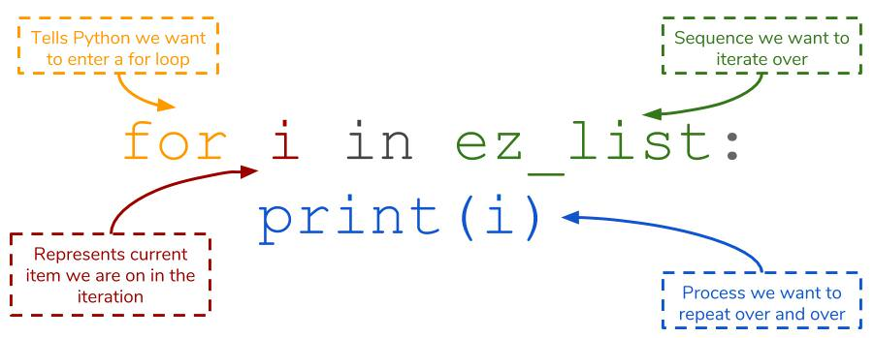
Iterate a python list :
# Example :
ez_list = [1, 2, 3]
for i in ez_list:
print(i)
#output: 1 2 3

Slide 7
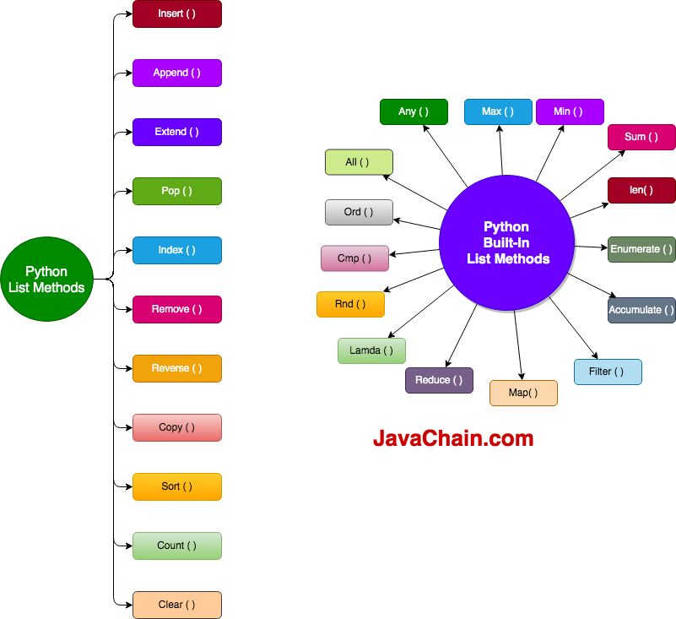
Python list methods and functions:

Slide 8
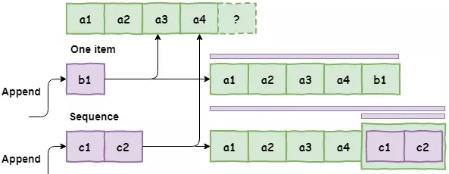
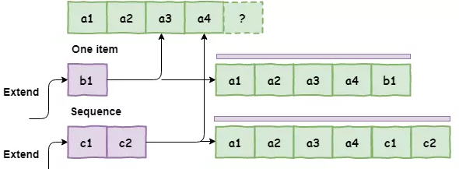
Difference between append() and extend():

Slide 9
Bulit in methods for list:

Slide 10
List Comprehension:
It helps in constructing lists in a completely natural and easy way.
List1 = [iter for iter in oldList if condition]
Example
list_fruit = [“Apple”, “Mango”, “Banana”, “Avocado”]
first_letters = [ fruits[0] for fruits in list_fruit ]
print(first_letters)
#Output:
[‘A’, ‘M’, ‘B’, ‘A’]

Slide 11
Dynamic Input in List:
There are two ways to take dynamic input in list form user :
Using For Loop
Using split() method
# Example1 :
List1=[]
for i in range(0,5):
List1.append(int(input()))
# Example2 :
Str1 = input(“Enter string separated by space : ”)
List1 = str1.split()

Slide 12
Multi Dimensional List:
row=2
col=3
# multidimensional list with user inputs
list1 = [[int(input("Enter Element : ")) for x in range(col)] for x in range(row)]
print("list1 = ",list1)
# multidimensional list with all same inputs
list2= [ [int(input("Enter an element : "))] * col ] * row
print("list2 = ",list2)

Slide 13
Tuple in Python:
Creating tuple
Using () brackets
Using tuple() method
Example:
Tup1 = (1,2,3,"vini")
Tup2 =tuple()

Slide 14
All operations of tuple are same as list.
But tuple is immutable so we cannot change the element of tuple.
Tuple does not support assignment.
We can concate multiple tuples.
Example :
Tup1 = (1,2,3)
Tup2 = ('A','B','C')
Tup3 = Tup1 + Tup2
Tup1[2] = "vini" # error

Slide 15
Deleting tuple:
We cannot delete the element of tuple.
But we can delete the whole tuple.
Using del keyword

Slide 16
Set in Python
A set is an unordered collection of items in which every element is unique, Iterable and each item of set is immutable (cannot be modified).
However, the set as a whole is mutable.
When should you use Set?
An order doesn’t matter
Repetition is not required
For mathematical operations

Slide 17
Creating set in Python:
Using curly braces
Set1 = {1,2,3,(1,2,3)}
Using Set () function
Set1 = set({1,2,3,(1,2,3)})
Empty set
Set1 = set()

Slide 18
Modify set in Python:
Using add() # for adding single element
Set1 = {1,2,3}
Set1.add(5)
Using update() # for adding multiple elements
Set1.update([1,2,3,4]) # 1,2,3 are added only once
Set2 = {'A','B','C'}
Set1.update(Set2)

Slide 19
Remove element from a set in Python:
Using remove()
If element is not present in set then it will throw an error
Using discard()
If element is not present in set then it will not throw an error

Slide 20
Access element from a set in Python:
A set element cannot be referenced by an index number since it is unordered.
Using for loop
Using in keyword
if element is present in set then it will return True, and if element is not present in set then it will return False.

Slide 21
Copy Clear and Sorting for set:
For copy:
Using copy()
For clear:
Using clear()
For sorting:
Using sorted()

Slide 22
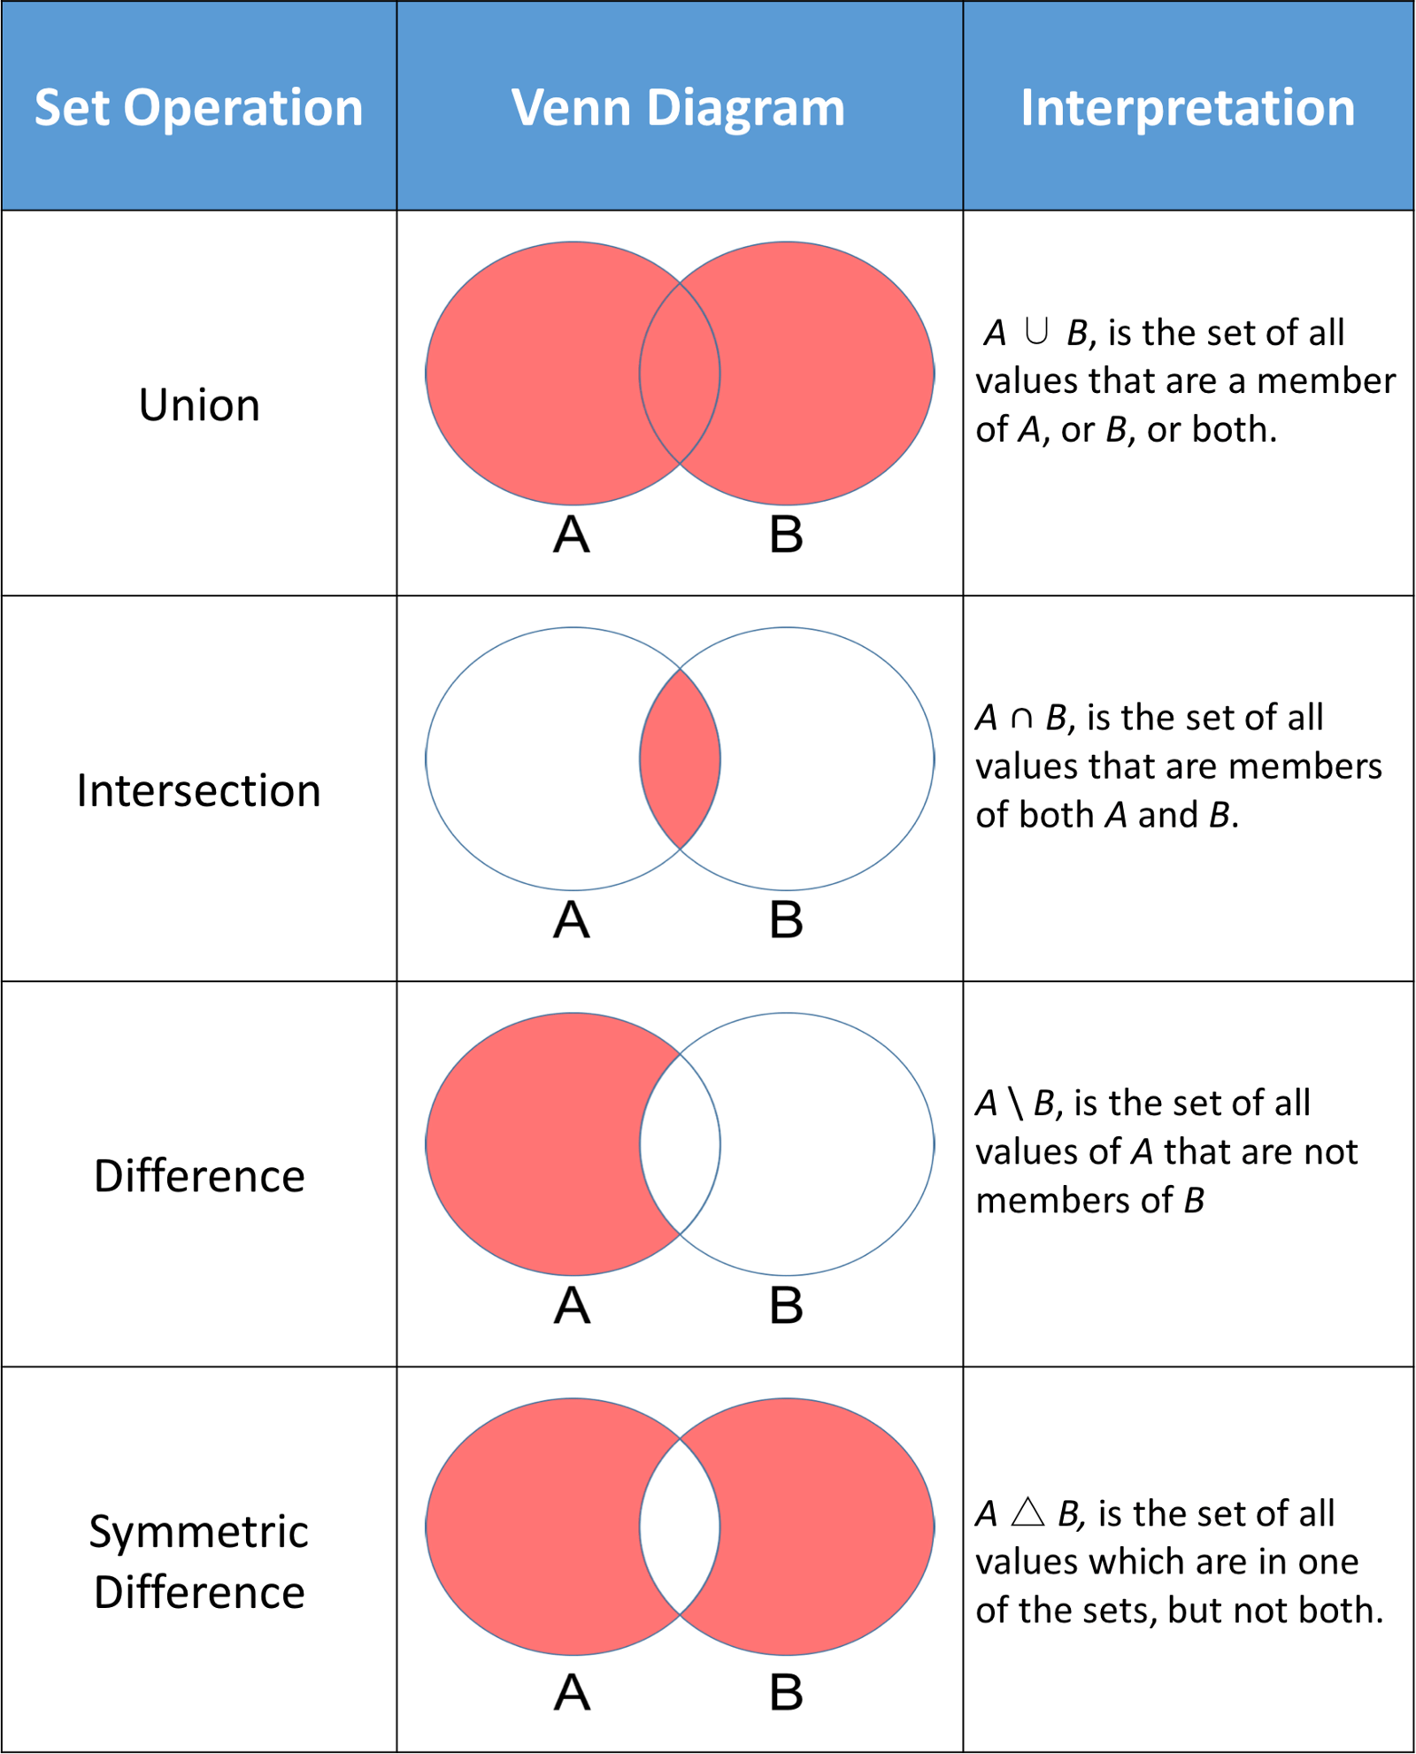
Set Operations:

Slide 23
Subset and Superset:
You can use the <= operator or issubset() method to check if a set is a subset of another set. If it is, it would return True else it would return False.
You can use the >= operator or issuperset() method to check if a set is a superset of another set.

Slide 24
Frozen set:
Frozen is immutable in python.
syntax :
frozenset([iterable])
The frozenset() method can take only a single parameter.
The iterable is optional. The iterable contains elements for initializing the frozen set.
The frozen set are immutable and you cannot perform operations such as add(), remove(), update(), etc.

Slide 25
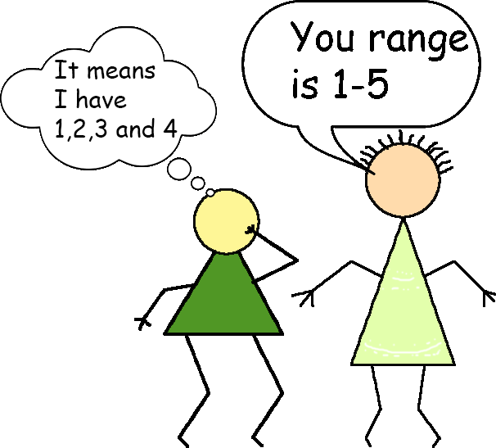
Range in Python

Slide 26
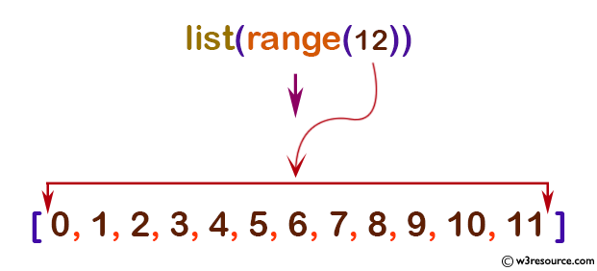
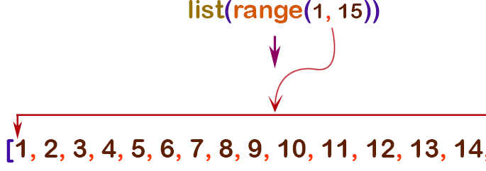
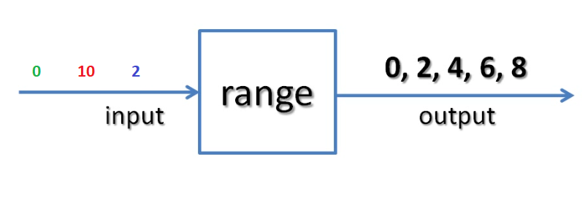
Syntax of range(): range(start, stop[, step])

Slide 27
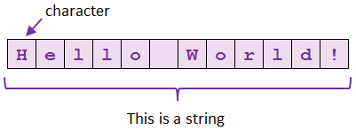
String in Python
String can be defined as a sequence of characters
Syntax: String1 = “Hello World”
Accessing string (using index or slicing)
Updating string (Immutable)

Slide 28
String methods:
lower()
upper()
find()
max()
strip()
replace()
join()
index()
isalnum()
isalpha()
isdigit()
islower()
isupper()
len()
splitlines()
min()
capitalize()
count()
expandtabs()
encode()

Slide 29
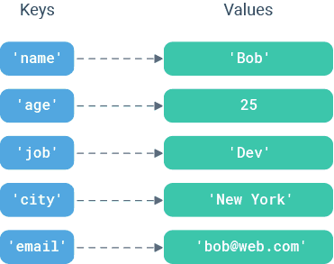
Dictionary in Python
dictionary as a set of key:value pairs; where each key is mapped to a single value.

Slide 30
Dictionary operations:
Create dictionary
Dict1= {"key" : "value"} OR using dict() method
Access dictionary items
Using key OR using get() method
Add/update dictionary
Change the value of any key
Merge two dictionary ( using update() method)
Remove dictionary item
Using del, pop() and popitem()

Slide 31
Get All Keys, Values and Key:Value Pairs
Using keys()
Using values()
Using items()

Slide 32
Iterate a dictionary:
D = {'name': 'Vini',
'age': 20,
'job': 'Trainee'} for x in D:
print(x) # print keys
print(D[x]) # print values

Slide 33
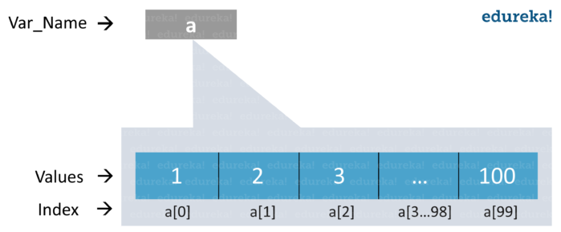
Array in Python
when you import using arr alias
a=arr.array(data type,value list)
OR
when you import using *
a=array(data type,value list)
Example:
a=arr.array( ‘d’ , [1.1 , 2.1 ,3.1] )

Slide 34
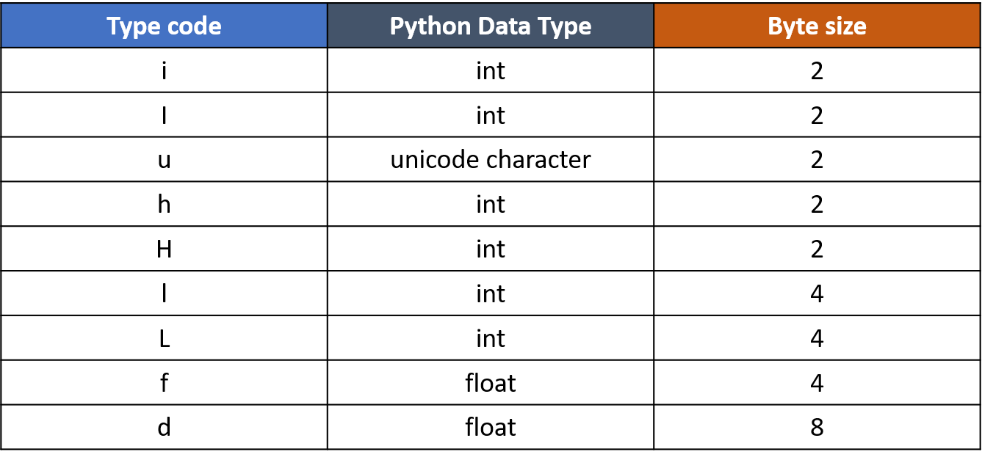
Types of Array

Slide 35
Difference between list and array:
List can have different types of elements.
But, array contains only simillar type of elements.
Operations perform on array are same as list
i.e. append(), extend(), pop()
We can iterate through array
We can access elements of array by using index and slicing

Slide 36
Creating Multidimensional array:
Array = [ [0] * c ] * r ] # with each element value as 0
Hence in such case if we change any element to 5 then the whole array will have 5 as values in each element place of the same column as below:
Array[0][0] = 5 | 5, 0, 0 | | 5, 0, 0 | | 5, 0, 0 |

Slide 37
Creating Multidimensional array:
Another way to declare an Array is by using a generator with a list of ‘c’ elements repeated ‘r’ times. The declaration can be done as below:
c = 4 r = 3 Array = [ [0] * c for i in range(r) ] print(Array) #output: [[0, 0, 0, 0], [0, 0, 0, 0], [0, 0, 0, 0]]

Slide 38


